Slide 1
MATHEMATICS I
FIRST SEMESTER
05
Trigonometric Functions
By Dr. Shaimaa Amen/Material engineering
department /1st Grade/Calculus I

Slide 2
Outlines
Radian Measure
Types and Trigonometric Relation
Periodicity and Graphs of the Trigonometric Functions
Even and Odd Trigonometric Functions
Identities
  Addition Formulas
  Double-Angle Formulas
  Half-Angle Formulas
The Law of Consines

Slide 3
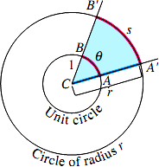
Trigonometric Functions
The trigonometric functions are important because they are periodic, or repeating,
and therefore model many naturally occurring periodic processes.
Radian Measure
The radian measure of the angle ACB at the center of the unit circle equals the length of the arc that ACB cuts from the unit circle. Figure shows that is the length of arc cut from a circle of radius r when the subtendingangle

Slide 4


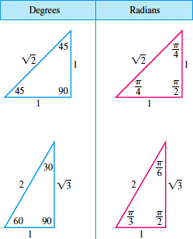
For example:
45° in radian measure is
in radian measure is
Figure shows the angles of two common triangles
in both measures.

Slide 5
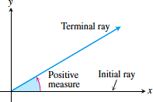
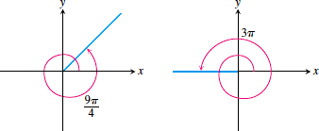
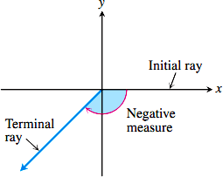
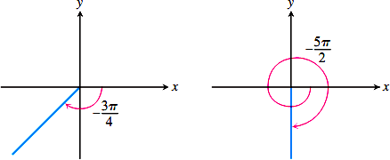
measured counterclockwise from the positive x-axis are assigned positive measures; angles measured clockwise are assigned negative measures.

Slide 6
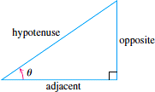
Types and Trigonometric Relation
The Six Basic Trigonometric Functions
sinθ= ^{opp}
cosθ= ^{adj}
hyp
hyp
tanθ=
opp
cotθ= ^{adj}
opp
adj
secθ= ^{h yp}
cscθ= ^{hyp}
adj
opp

Slide 7
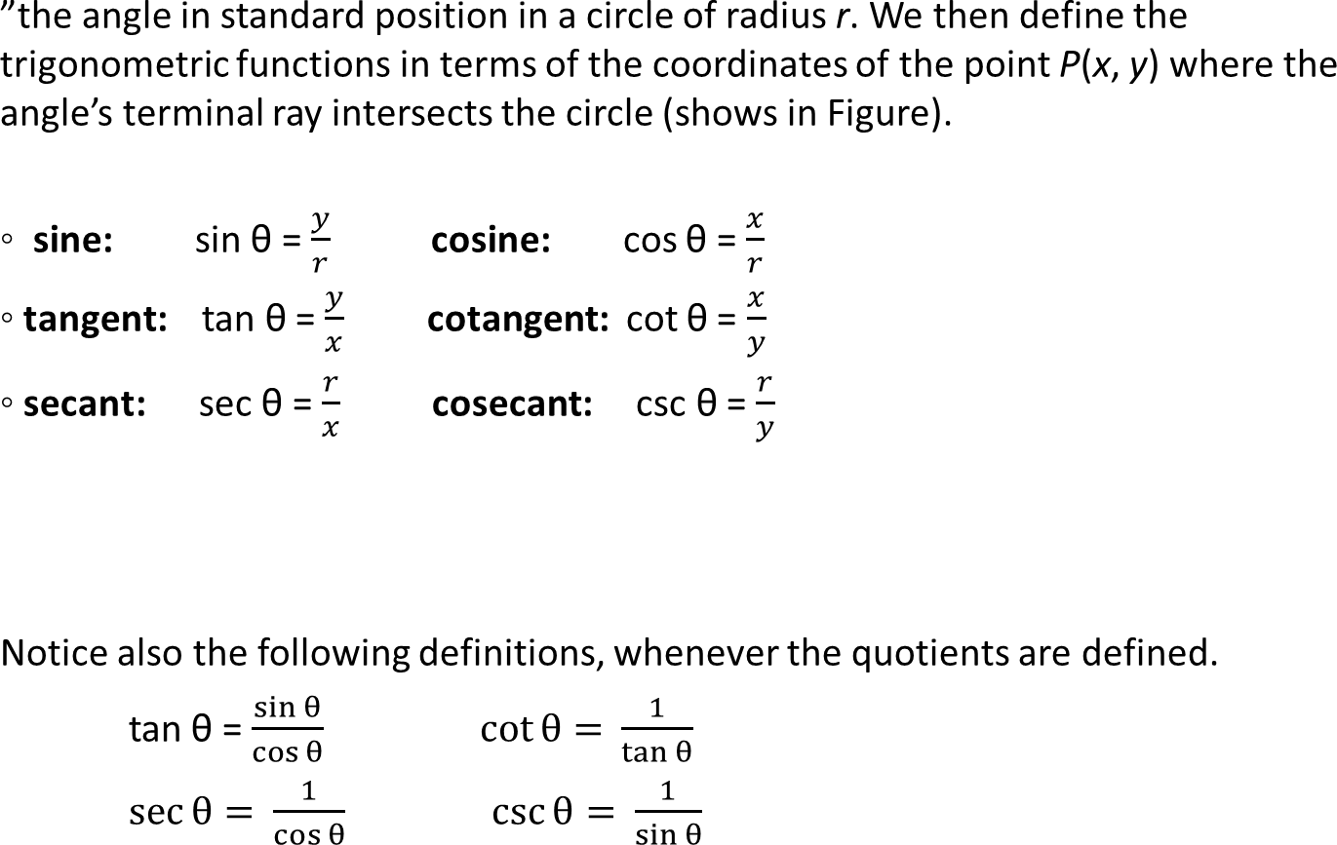
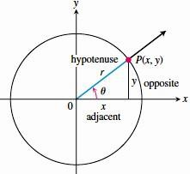

Slide 8
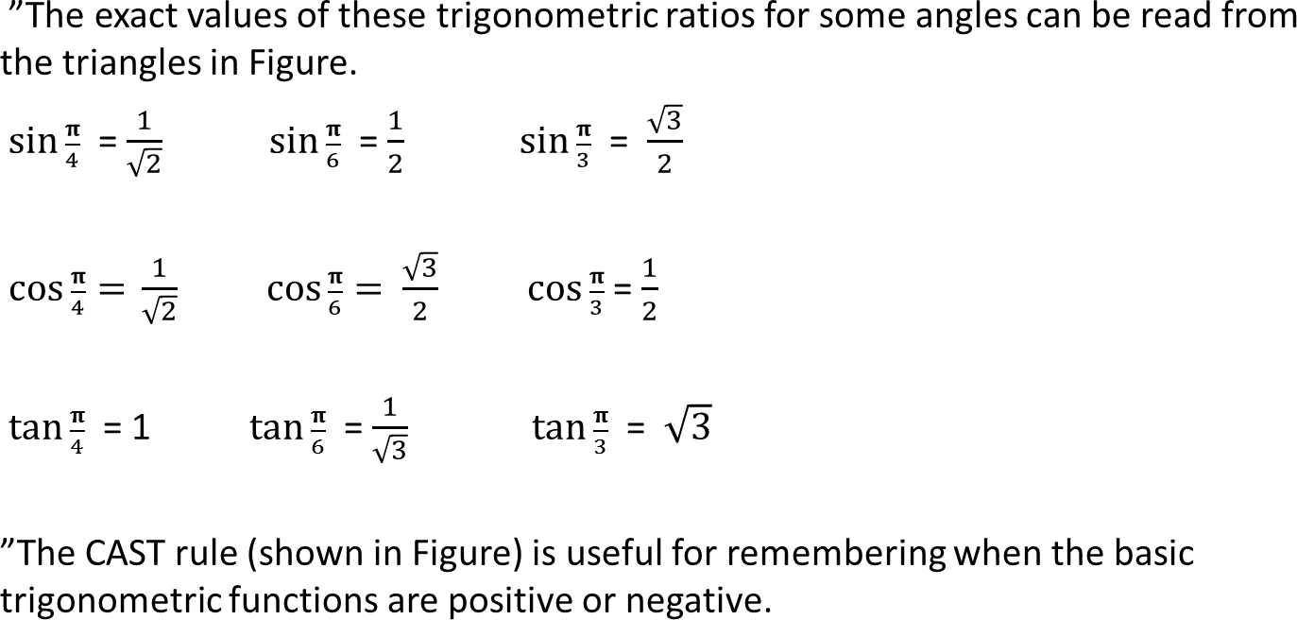
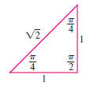

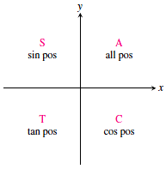

Slide 9
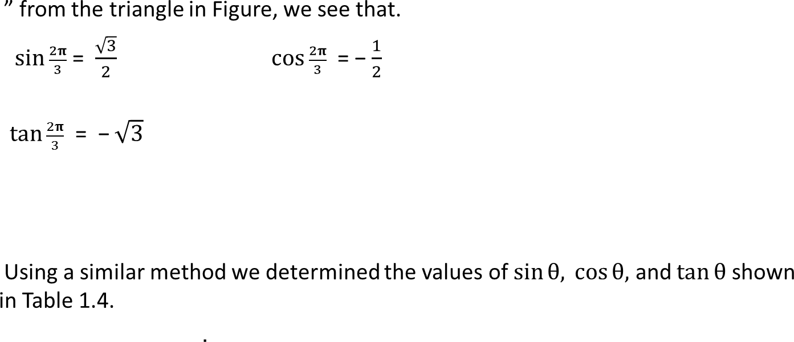
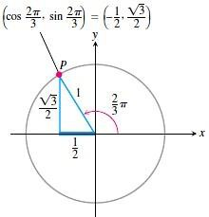
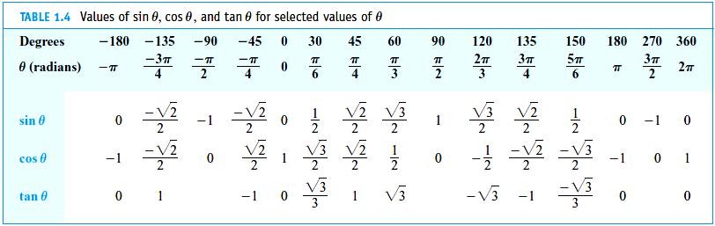

Slide 10
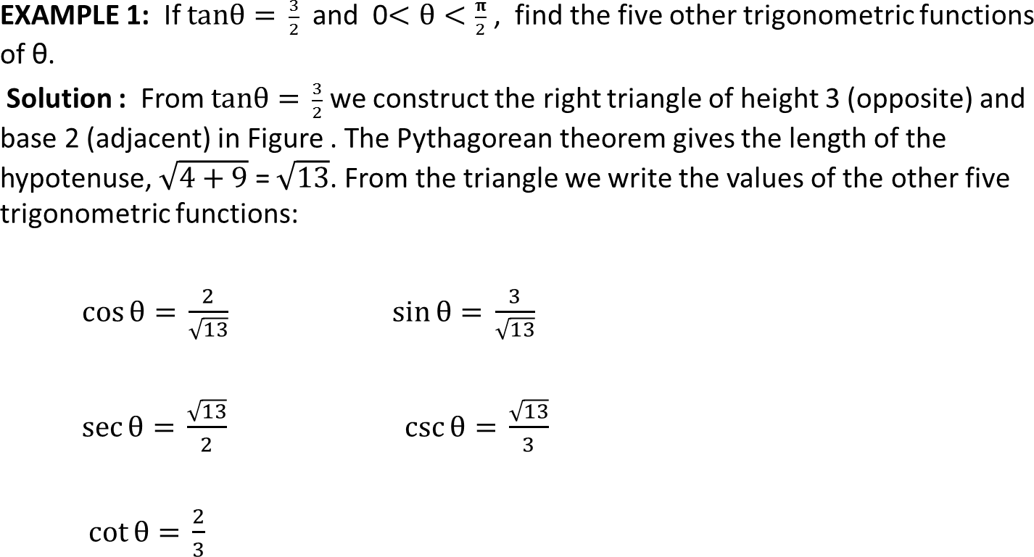
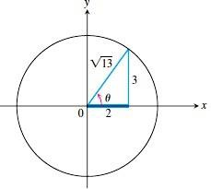

Slide 11
MATHEMATICS I
FIRST SEMESTER
Graph of Trigonometric
Functions
06
By Dr. Shaimaa Amen/Material engineering
department /1st Grade/Calculus I

Slide 12
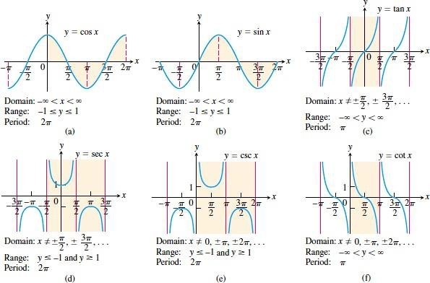
Periodicity and Graphs of the Trigonometric Functions
Periodic Function: A function ƒ(x) is periodic if there is a positive number psuch
that f(x+p) = f(x) for every value of x. The smallest such value of p is the period of ƒ.
”graph trigonometric functions in the coordinate plane: See Figure,

Slide 13
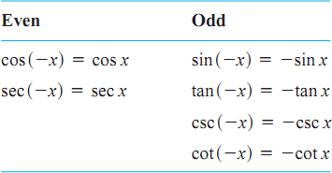
As we can see in Figure the tangent and cotangent functions have period The other four functions have period
Even and Odd Trigonometric Functions
The symmetries in the graphs in Figure reveal that the cosine and secant functions are even and the other four functions are odd:

Slide 14

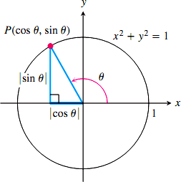

Identities
The coordinates of any point P(x, y) in the plane can be expressed in terms of the point’s distance from the origin and the angle that ray OP makes with the positive x-axis (shown figure)
When we can apply the Pythagorean theorem to the reference right triangle in Figure and obtain the equation r = 1

Slide 15

Addition Formulas
There are similar formulas for
cos(A − B) = cos Acos B + sin Asin B
sin(A − B) = sin Acos B − cos Asin B

Slide 16



Double-Angle Formulas
Half-Angle Formulas

Slide 17
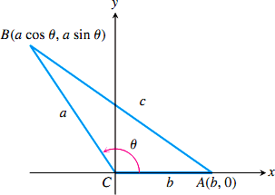
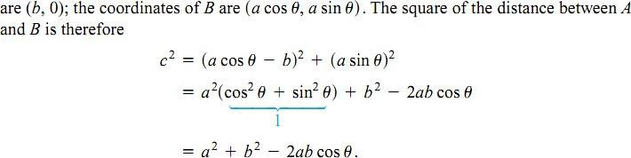
The Law of Cosines
This equation is called the law of cosines. as in Figure the coordinates of A

Slide 18
